Slide 1


PEEPHOLE OPTIMIZATION IN COMPILER DESIGN
CAPSTONE PROJECT

Slide 2
PEEPHOLE OPTIMIZATION IN COMPILER DESIGN
WORK DONE BY:
T.NAGAVEERANJINEYULU(192211998)
V.SATWIK REDDY(192210148)
ALLAM PRATHAP(192210163)
GUIDED BY:
Dr. N.DEEPA
CSA1482-COMPILER DESIGN
SAVEETHA SCHOOL OF ENGINEERING

Slide 3
QUESTION
Why is peephole optimization important in compiler design?
Peephole optimization is important in compiler design because it helps to fine-tune the generated machine code by identifying and correcting small inefficiencies. By focusing on local optimizations, such as removing redundant instructions or replacing suboptimal instruction sequences, peephole optimization can significantly improve the performance and resource efficiency of the final program. This contributes to faster execution times and reduced resource usage, which is crucial for creating high-performance software.

Slide 4
PROJECT PLAN
Implementing peephole optimization in a compiler involves improving machine code efficiency by replacing suboptimal instruction sequences with optimized ones. The project plan includes planning and requirements gathering, design, implementation, testing, documentation and training, and deployment and maintenance. Initially, goals are defined and inefficiencies identified. The design phase develops algorithms to recognize and replace inefficient sequences. Implementation integrates the optimizer into the compiler. Rigorous testing ensures functionality and performance, followed by documentation and training. Finally, the optimizer is deployed, with ongoing monitoring and maintenance to address issues, ensuring significant performance and efficiency enhancements in the compiled code.

Slide 5
SOFTWARE & HARDWARE REQUIREMENTS
SOFTWARE REQUREMENTS
Operating System: Windows, macOS, or Linux
IDE: Visual Studio, Eclipse, or IntelliJ IDEA
Version Control: Git
Programming Languages: C/C++, Python, or Java
Compiler Framework: LLVM or GCC
Testing Frameworks: Google Test or Catch2
Documentation Tools: Doxygen, Markdown editors
CI/CD Tools: Jenkins, Travis CI, or GitHub Actions
HARDWARE REQUIREMENTS
Processor: Multi-core CPU (e.g., Intel i5/i7 or AMD Ryzen)
Memory: At least 8 GB of RAM

Slide 6
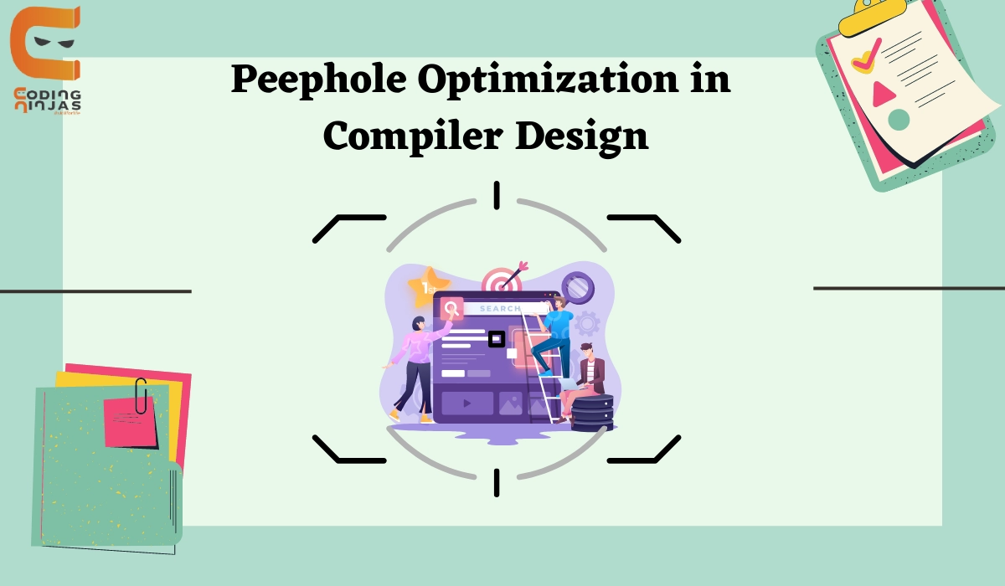
ABSTRACT
Optimization functions are crucial to compiler design.
Generally, compiler optimization divides into machine-independent optimization based on the intermediate language and machine-dependent optimization based on the object code.
Peephole optimization is a type of code Optimization performed on a small part of the code. It is performed on a very small set of instructions in a segment of code.

Slide 7

INTRODUCTION
Peephole optimization is a late-stage optimization technique developed in the 1960s and 1970s. Some compilers use peephole optimization as a paradigm for instruction selection.
Peephole optimization is an optimization technique performed on a small set of compiler-generated instructions, known as a peephole or window.
It basically works on the theory of replacement in which a part of code is replaced by shorter and faster code without a change in output. The peephole is machine-dependent optimization.

Slide 8
OPTIMIZATION TECHNIQUES
Redundant load and store elimination
Constant folding
Strength Reduction
Null sequences
Combine operations
Dead code Elimination

Slide 9
BENEFITS
OBJECTIVES
To improve performance
To reduce memory footprint
To reduce code size
Reduced Code Size
Enhanced Performance
Resource Efficiency

Slide 10
WORKING FLOW CHART:
BYTE CODE
REGISTER ALLOCATER
PARSER
OPTIMIZER
PEEPHOLE OPTIMIZER
INSTRUCTION SELECTOR
CODE GENERATOR
SCHEDULER
NATIVE CODE

Slide 11
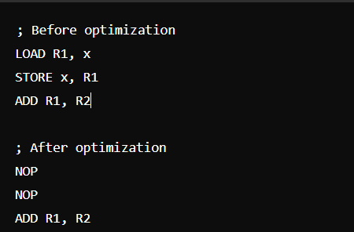
Project Code Name: "OptiPeephole"
void peepholeOptimize(std::vector<Instruction>& instructions) {
for (size_t i = 0; i < instructions.size() - 1; ++i) {
// Example pattern: replace "LOAD x; STORE x" with "NOP"
if (instructions[i].opcode == LOAD && instructions[i+1].opcode == STORE &&
instructions[i].operand == instructions[i+1].operand) {
instructions[i].opcode = NOP;
instructions[i+1].opcode = NOP;
}
}
}

Slide 12
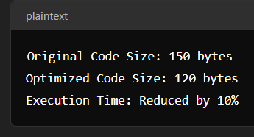
void compile(const SourceCode& source) { std::vector<Instruction> instructions = generateInstructions(source); peepholeOptimize(instructions); outputMachineCode(instructions); }

Slide 13
CONCLUSION
Peephole optimization is a valuable tool for compiler developers, providing tangible benefits in terms of code performance and efficiency.
Peephole optimization is a crucial technique in the realm of compiler design, focusing on enhancing the performance and efficiency of generated machine code.
This method can identify and eliminate redundancies, simplify instructions, and apply local optimizations that contribute to overall execution speed and resource efficiency.
Peephole optimization, though limited in scope to small sections of code, plays a significant role in the broader context of code optimization strategies.

Slide 14




